Slide 1
My Favourite Fruits Guess Game Challenge
Student: Felix Boaroog Atobiga
Course: Python Intermediate Hybrid
Location: Munich
Date: 27th November 2023
We use tech to connect human potential and
opportunity with dignity & humility

Slide 2
What is Website about and what is it meant to serve?
The tourist sites categorised according to the different landscapes and landmarks/features.
Where to search for and book accommodation.
Tourist Guides
Other services such as car rental and logistics
To serve as a one-stop shop providing multiple services to clients.

Slide 3
Why I undertook this project?
Challenge and Fun
To explore, incorporate and use multiple python functions

Slide 4
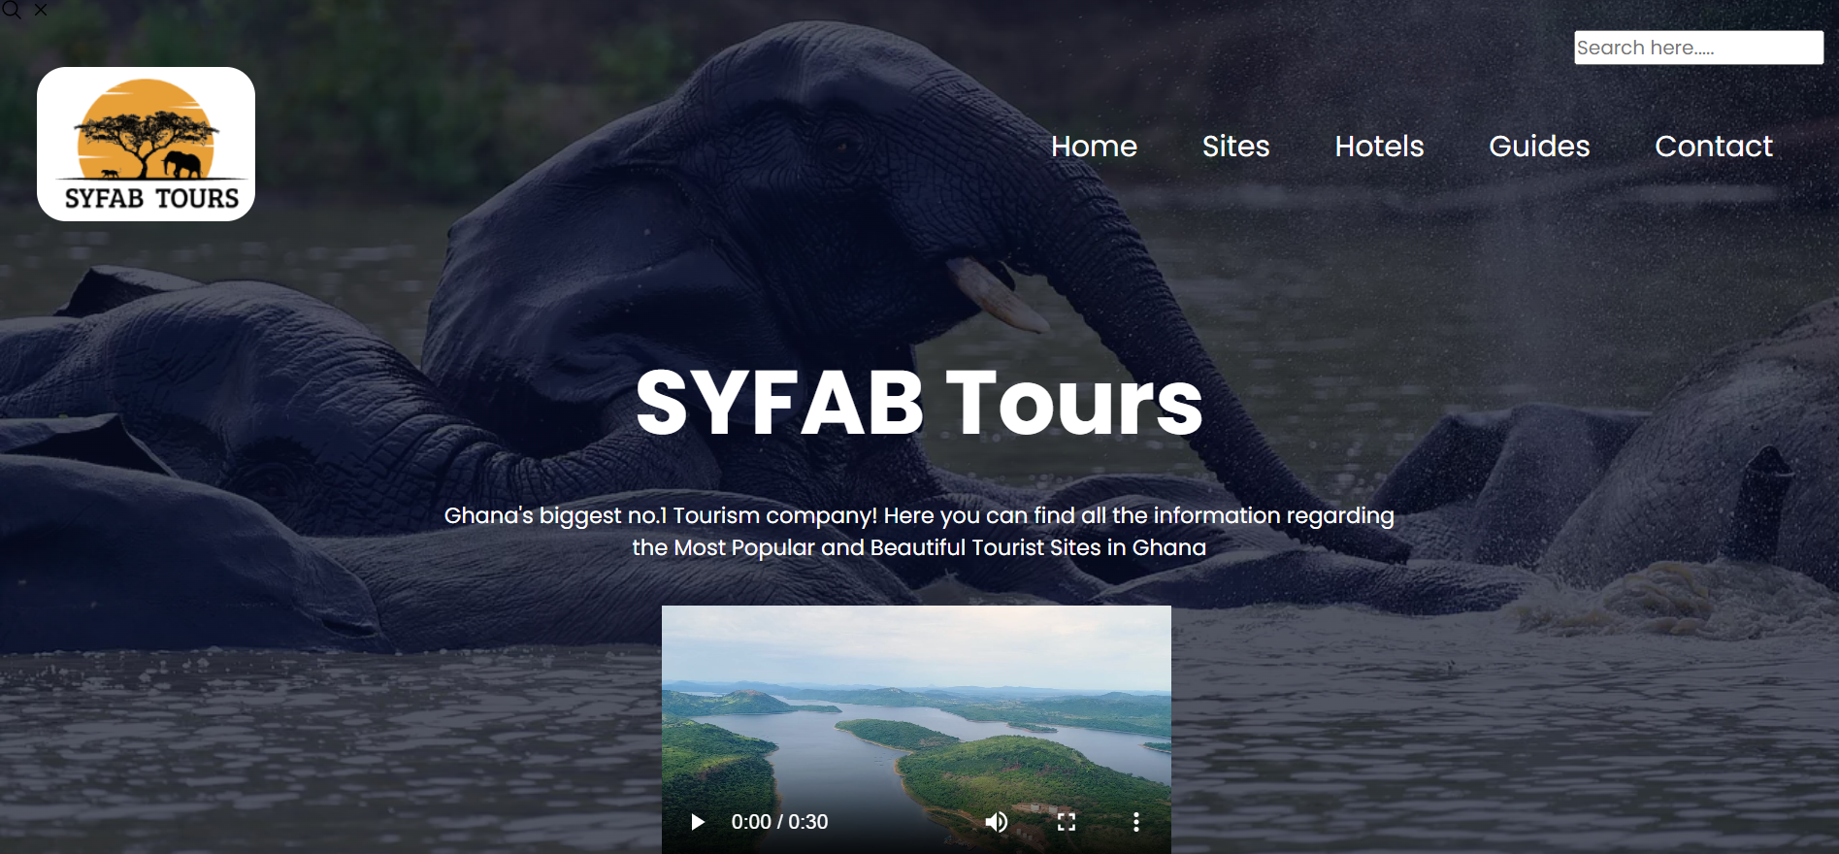
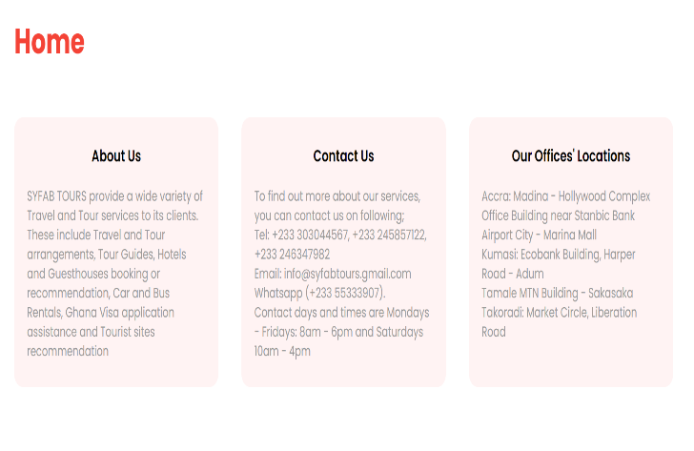
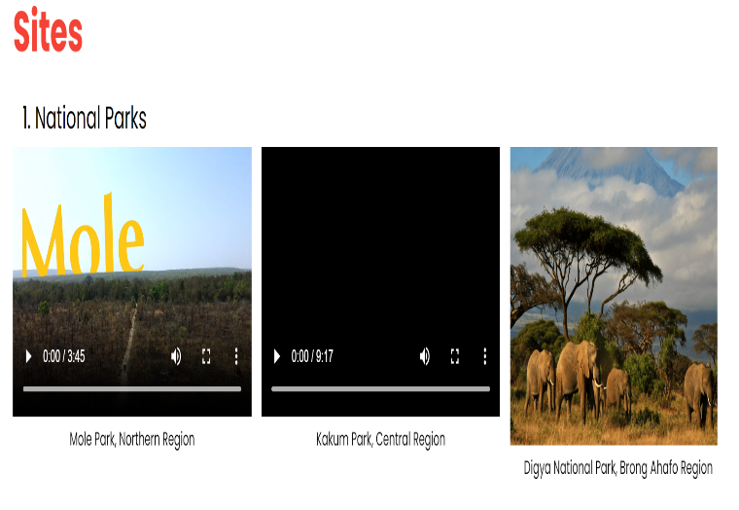
Snapshot of how the website looks

Slide 5
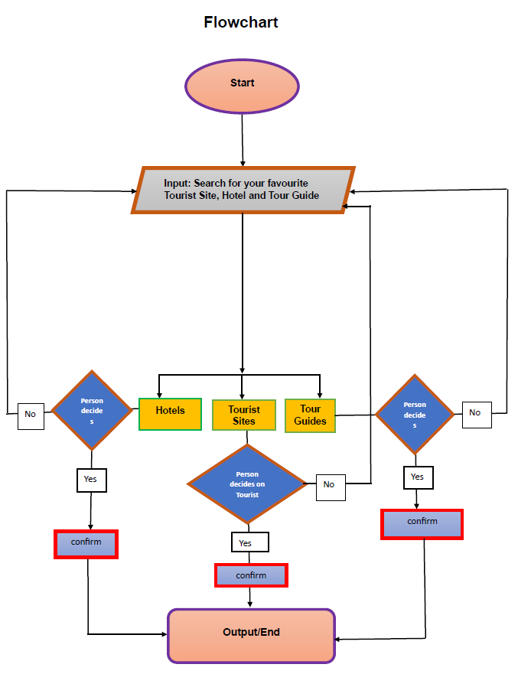
Flowchart

Slide 6
Python Functions used

Slide 7
Challenges and Future steps

Slide 8
Thank you for your attention!

